Slide 1

HCI Project
黄慧惠 12010336 | 安钧文 12012109 | 王思懿 12010339

Slide 2

01
Contents
目录
02
Highlights
directory
03
Novelties
04
Difficultis

Slide 3
02
Highlights
Color distinguishers
One-key actions
Fine-tuned parameters
Easy mouse controls

Slide 4
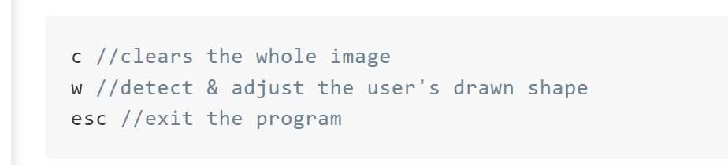
02
One-key actions
内容区域

Slide 5
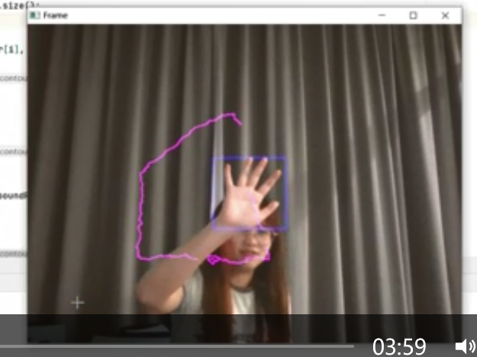
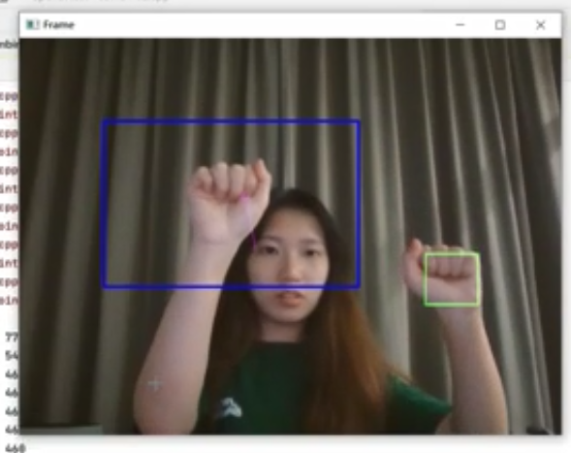
02
Color distinguishers
内容区域

Slide 6
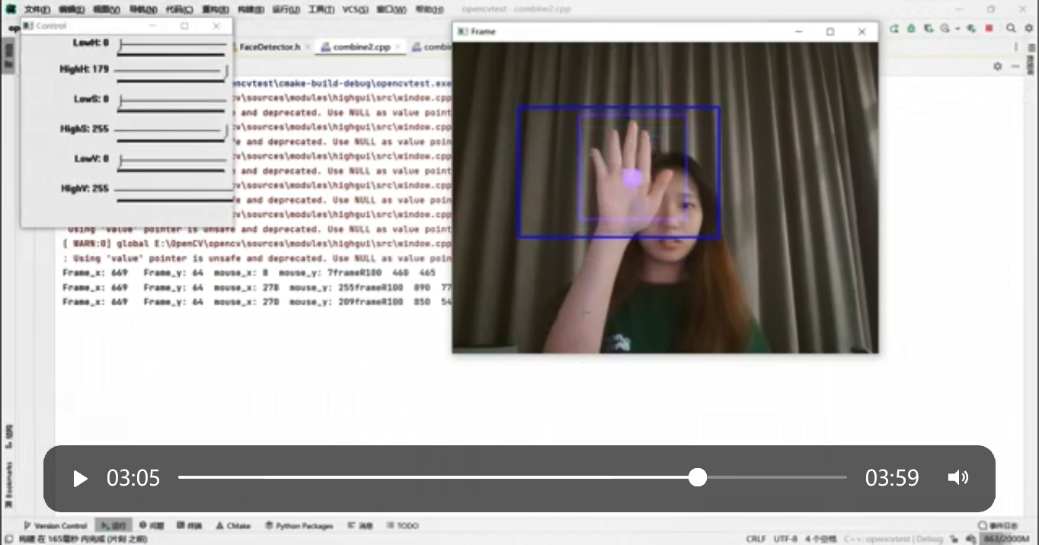
02
Easy mouse controls
内容区域

Slide 7
02
Fine-tuned parameters
Contents
fistCascade.detectMultiScale(gray, fist, 1.1, 2, CASCADE_SCALE_IMAGE, Size(30, 30));
lhandCascade.detectMultiScale(gray, lhand, 1.1, 2, CASCADE_SCALE_IMAGE, Size(30, 30));
rhandCascade.detectMultiScale(gray, rhand, 1.1, 2, CASCADE_SCALE_IMAGE, Size(30, 30));

Slide 8
03
Novelties
Set and Get volume by right hand
Improved drawing logic
Distinguish between rectangle and square

Slide 9
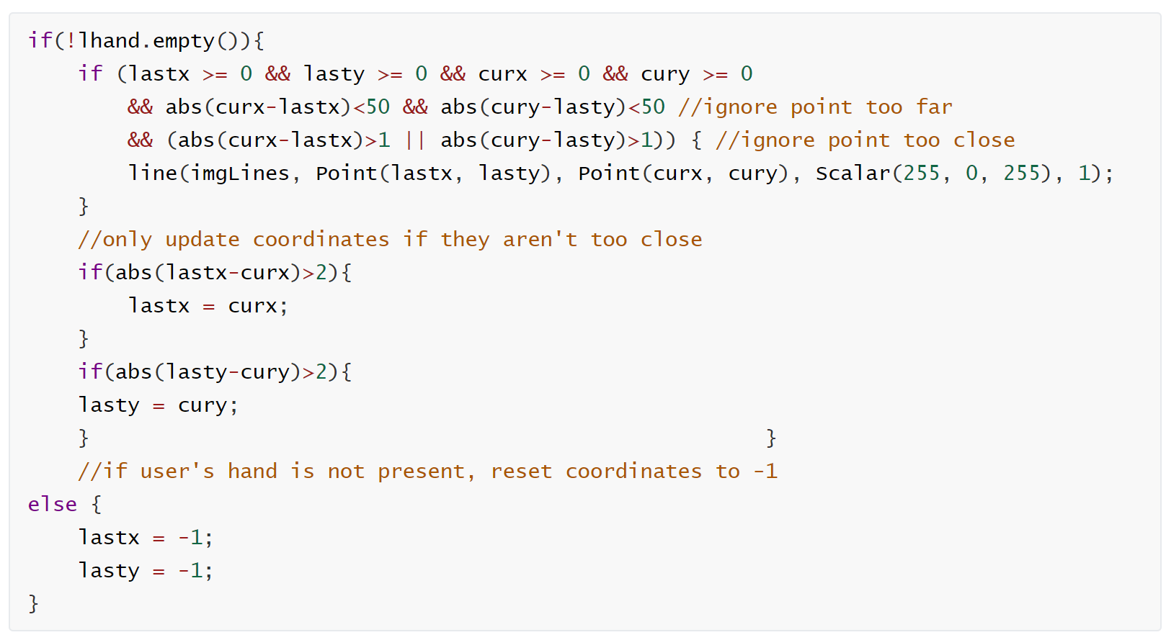
03
Improved drawing logic

Slide 10
03
Set and Get volume by right hand
libraries:
#include <mmdeviceapi.h>
#include <endpointvolume.h>
#include <audioclient.h>
#include <windows.h>
method:
bool SetVolum(int volume)
int GetVolume()

Slide 11
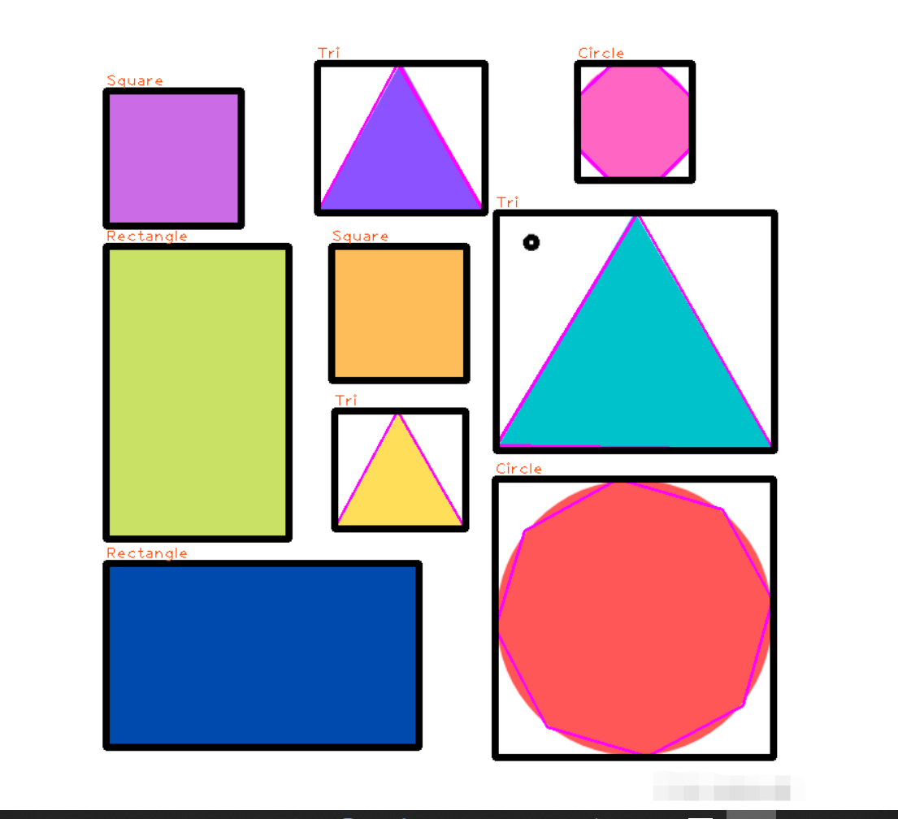
03
Support to distinguish between rectangle and square

Slide 12
04
Difficulties
Detection accuracy
Running efficiency
Model training

Slide 13
Thanks

